Slide 1

Zomato Restaurant
Analysis

Slide 2
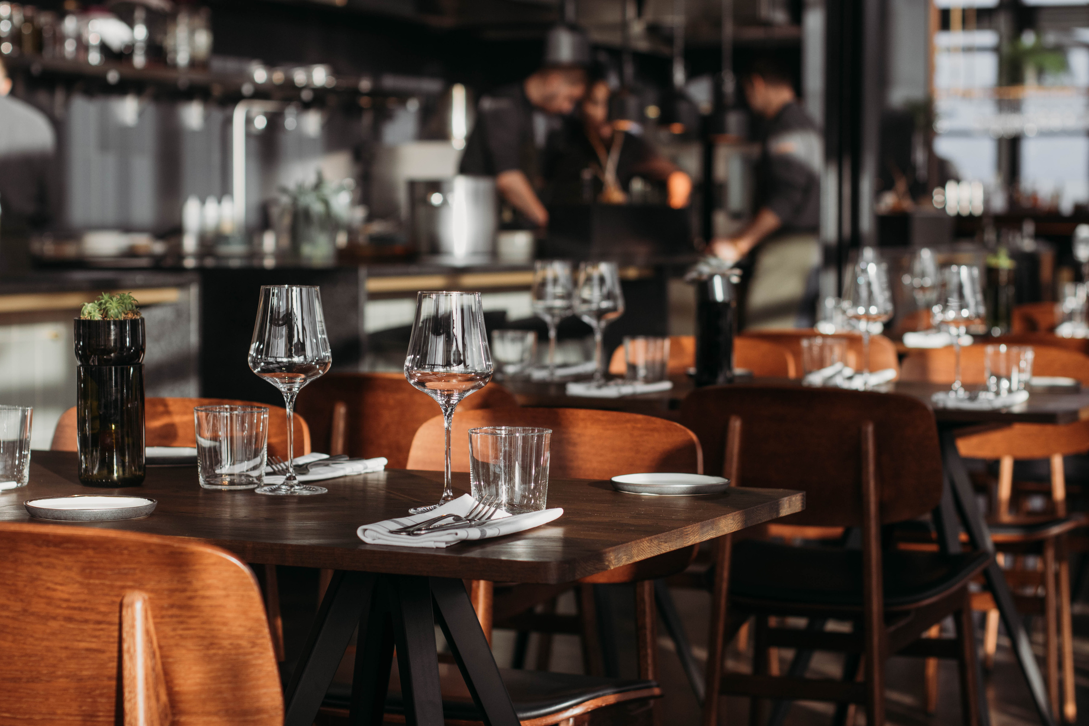
Exploring Restaurant Data...
What’s happening ?
This analysis encompasses collection of restaurants. With details on ratings, number of ratings, average cost for two people, and location.
• Number of observation : 6984
• Number of features :10
• Year of Analysis : 2022

Slide 3


Agenda
Top Restaurants
Number of ratings
Online vs offline
Each Location
online vs rating
Table booking
Average cost
summative analysis

Slide 4
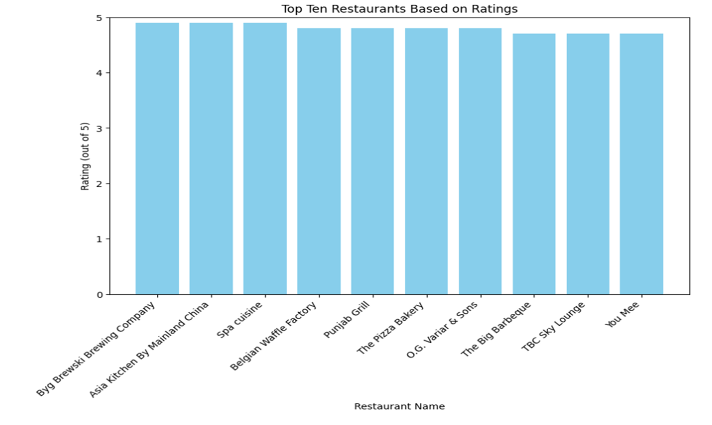
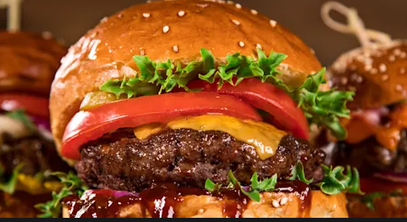
Provides Comfort and Deliciousness
In Every Dish
- Never Have a Bad Meal

Slide 5
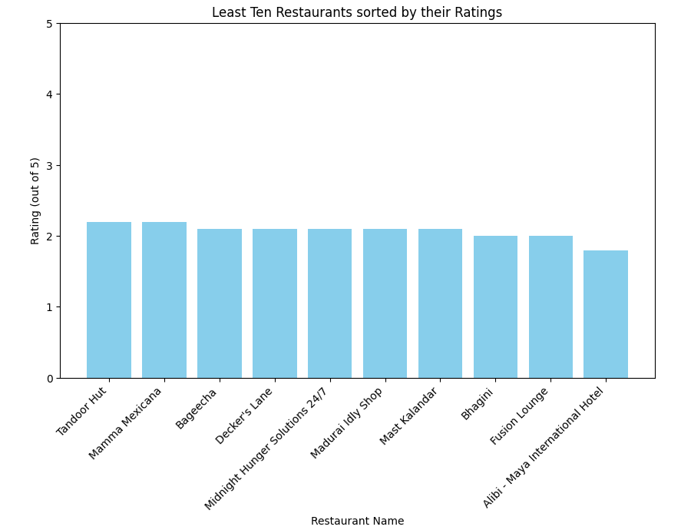
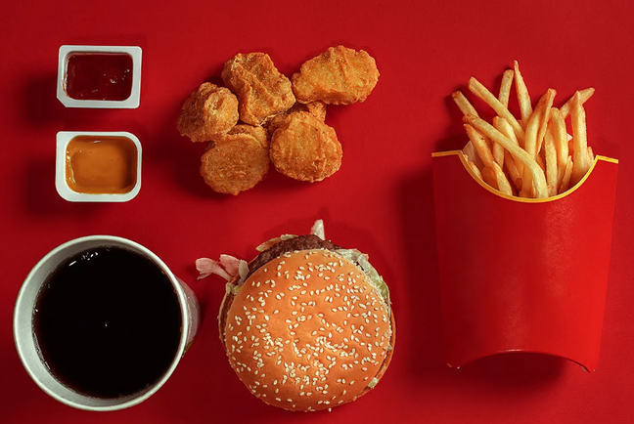
Love,Snacks

Slide 6
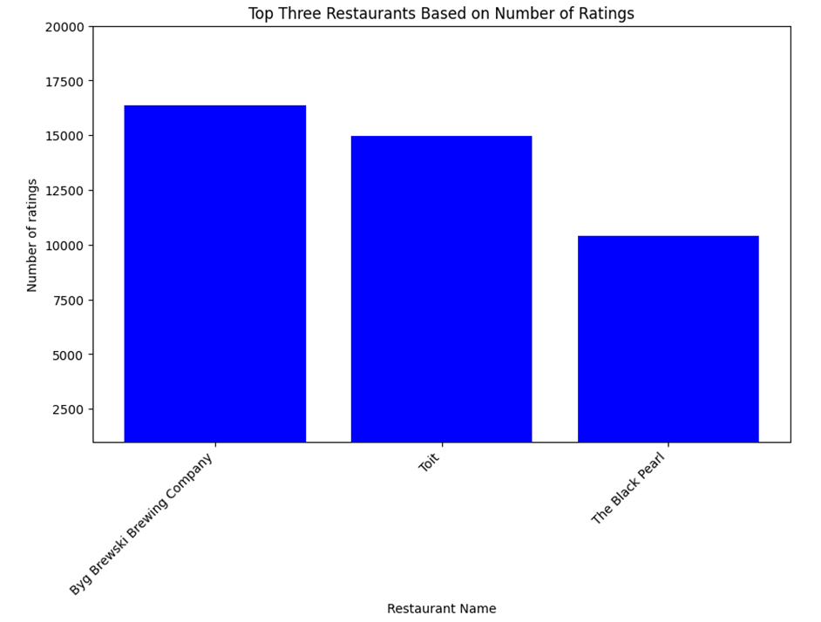
"Restaurant got
promoted by
people"

Slide 7
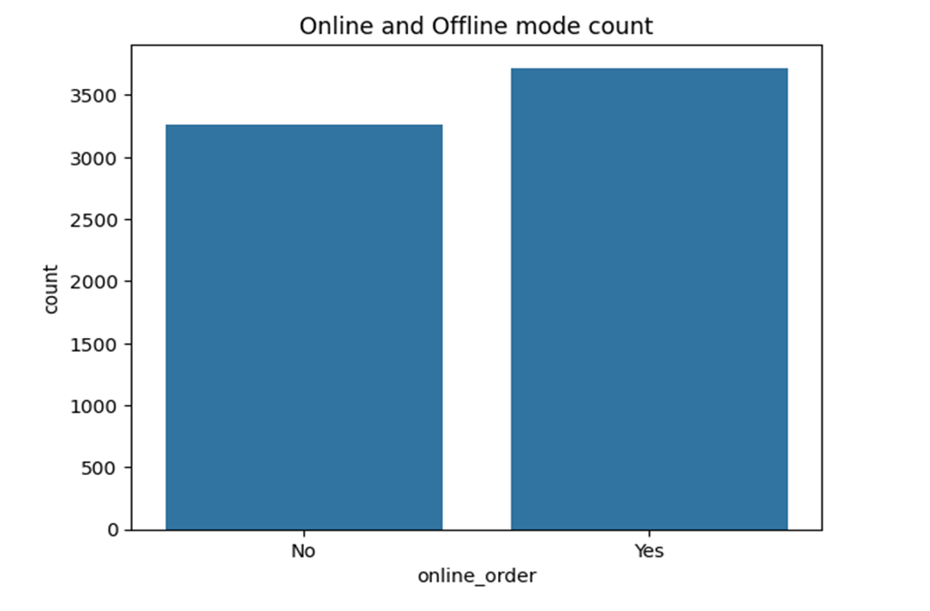

Online
vs
Offline

Slide 8
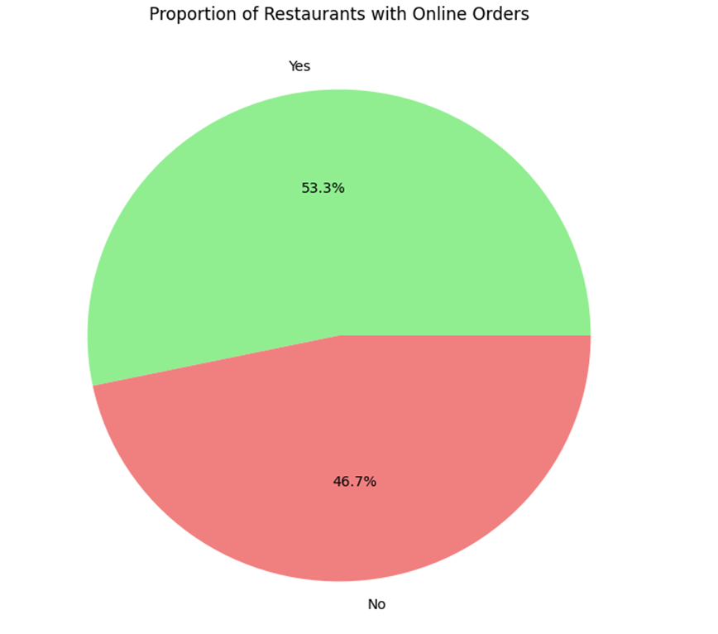

"%..."

Slide 9
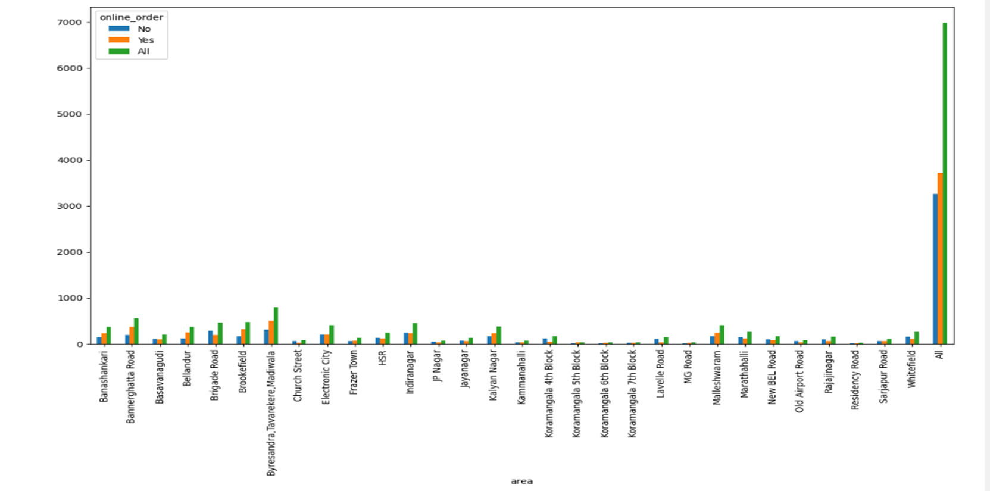
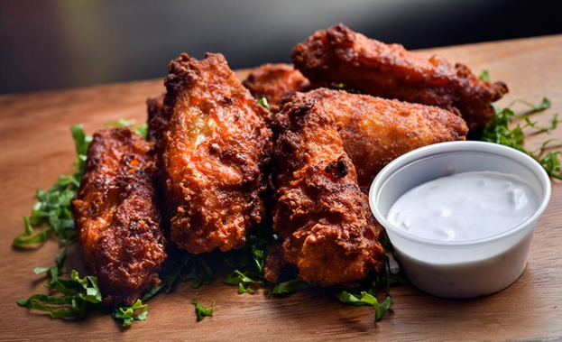
“Navigating
the
Future Online”

Slide 10
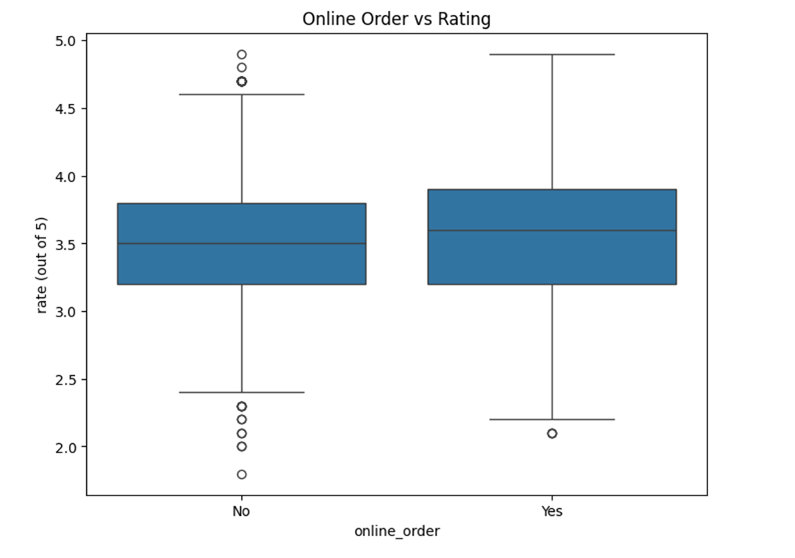
“Decoding
Digital
Diners”

Slide 11
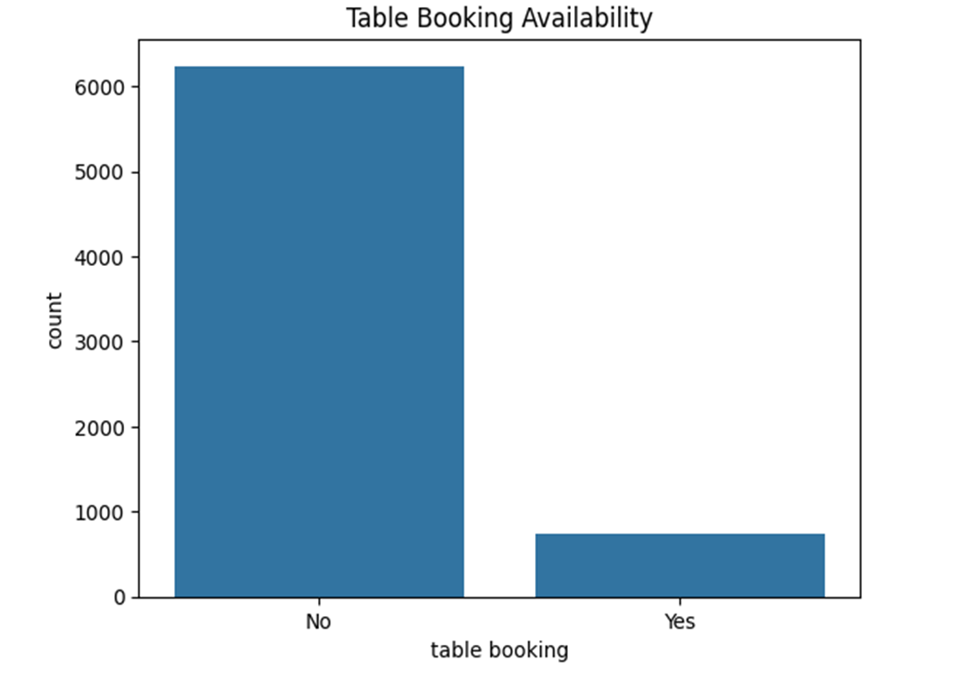
"Table
Availability"

Slide 12
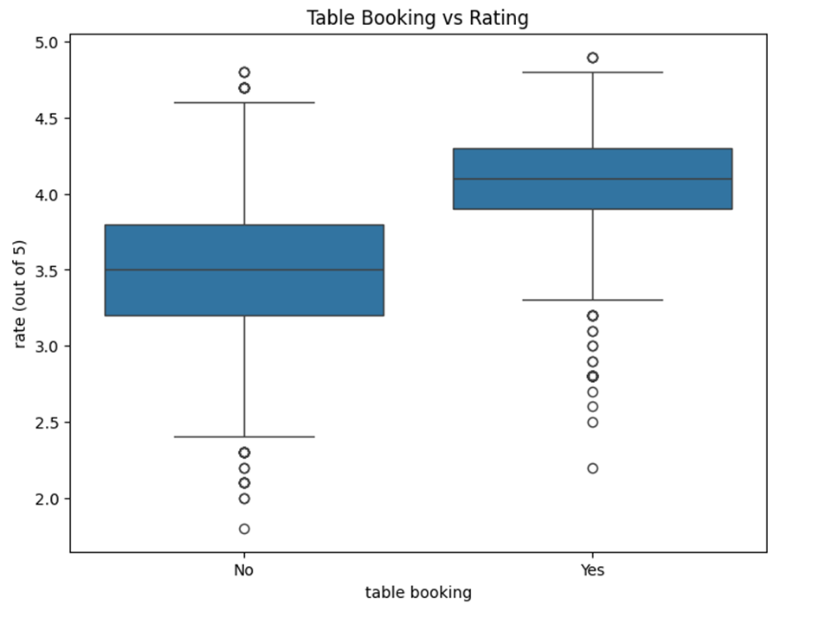

“Seamless
Reservations”

Slide 13
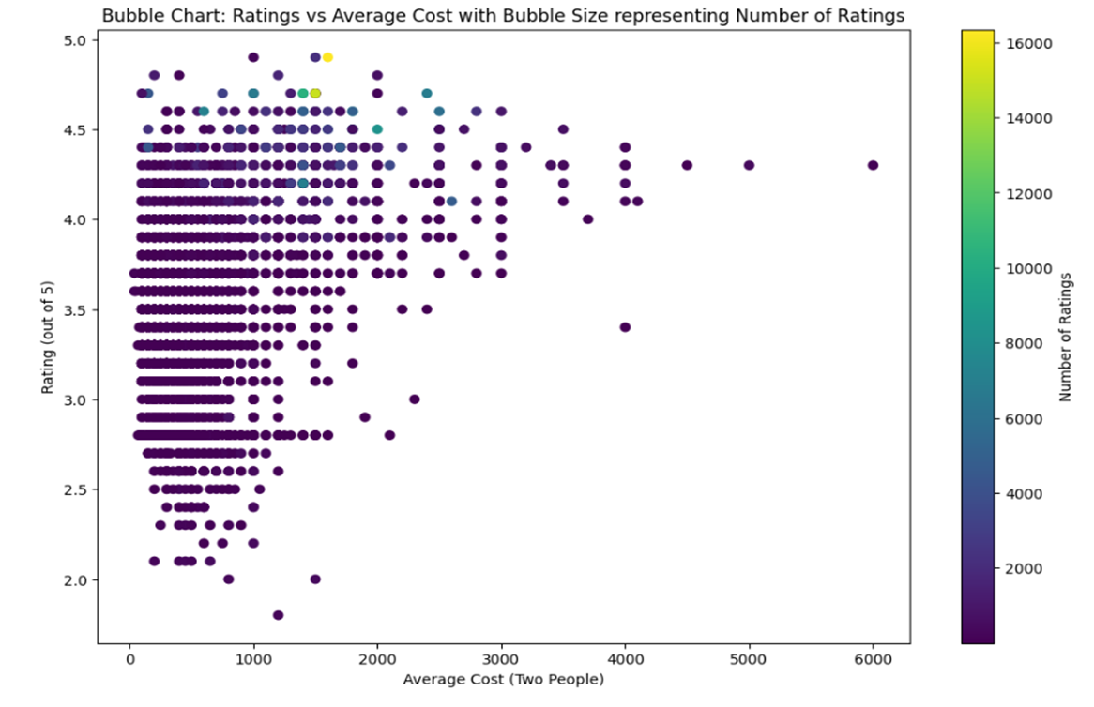


Slide 14
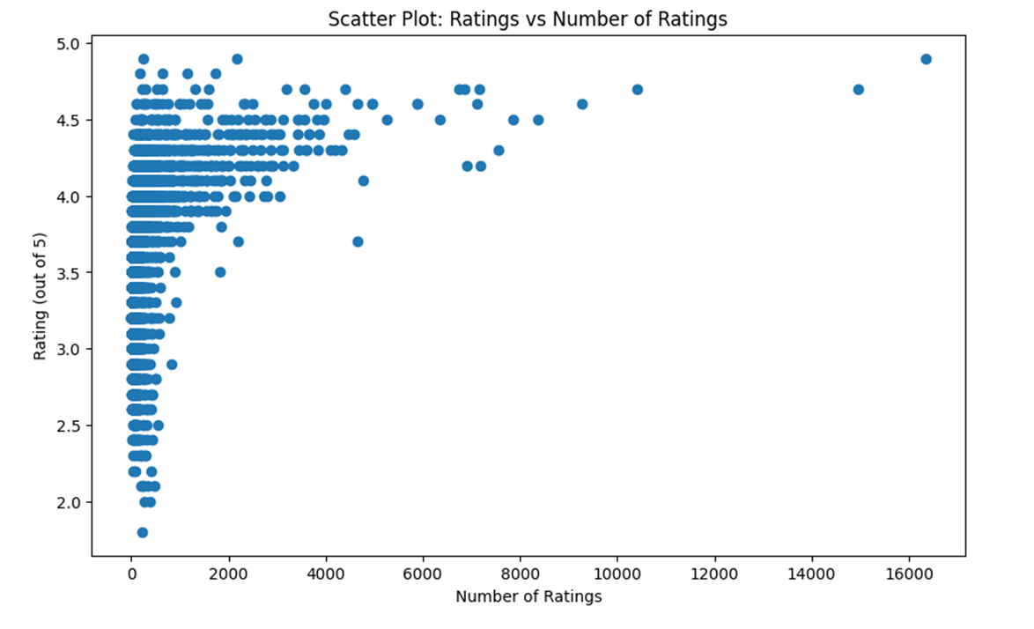
"Rating Metrics:
Exploring
the Relationship
Between
Ratings and Quantity"

Slide 15
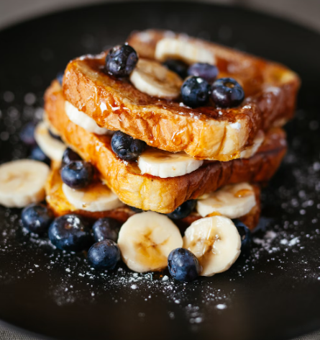
Summative Analysis:
Market Research
Location
Menu Innovation
Customer Feedback and Adaption
Financial Management
Training and Staffing
Technology Integration
Focus on Ambiance and Design

Slide 16

Thank
You

